Slide 1
The Mirenda Center for Sport Spirituality and Character Development
Zachary Heilman
Mechanical Option | 2011
Dr. Jim Freihaut | Dustin Eplee

Slide 2
The Mirenda Center for Sport Spirituality and Character Development
$96,000
$61,000
$35,000
38 kBtu/ sf yr
18 kBtu/ sf yr
20 kBtu/ sf yr
Existing
Proposed
Savings

Slide 3
Life & Learning Centers
Introduction
Bachmann
Building Function
The Circle
The Mirenda Center
Existing Mechanical System
U.S.A.
Ground Coupled Heat Pump
Cost Analysis
Mezzanine Proposal
Pennsylvania
Conclusion
Aston
Neumann University

Slide 4
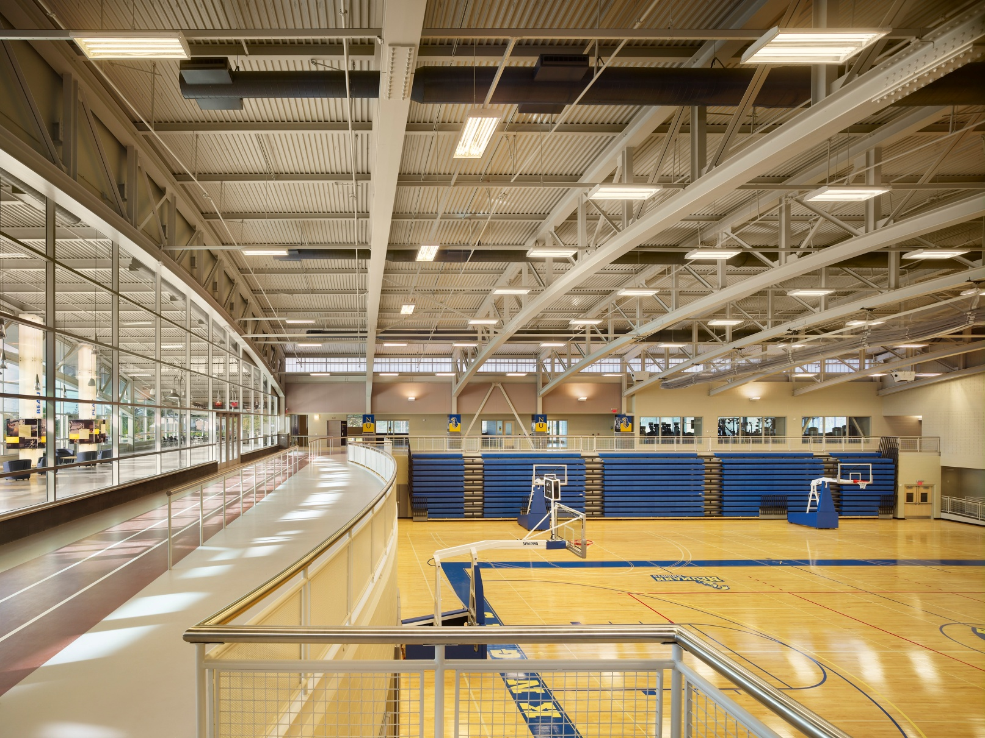
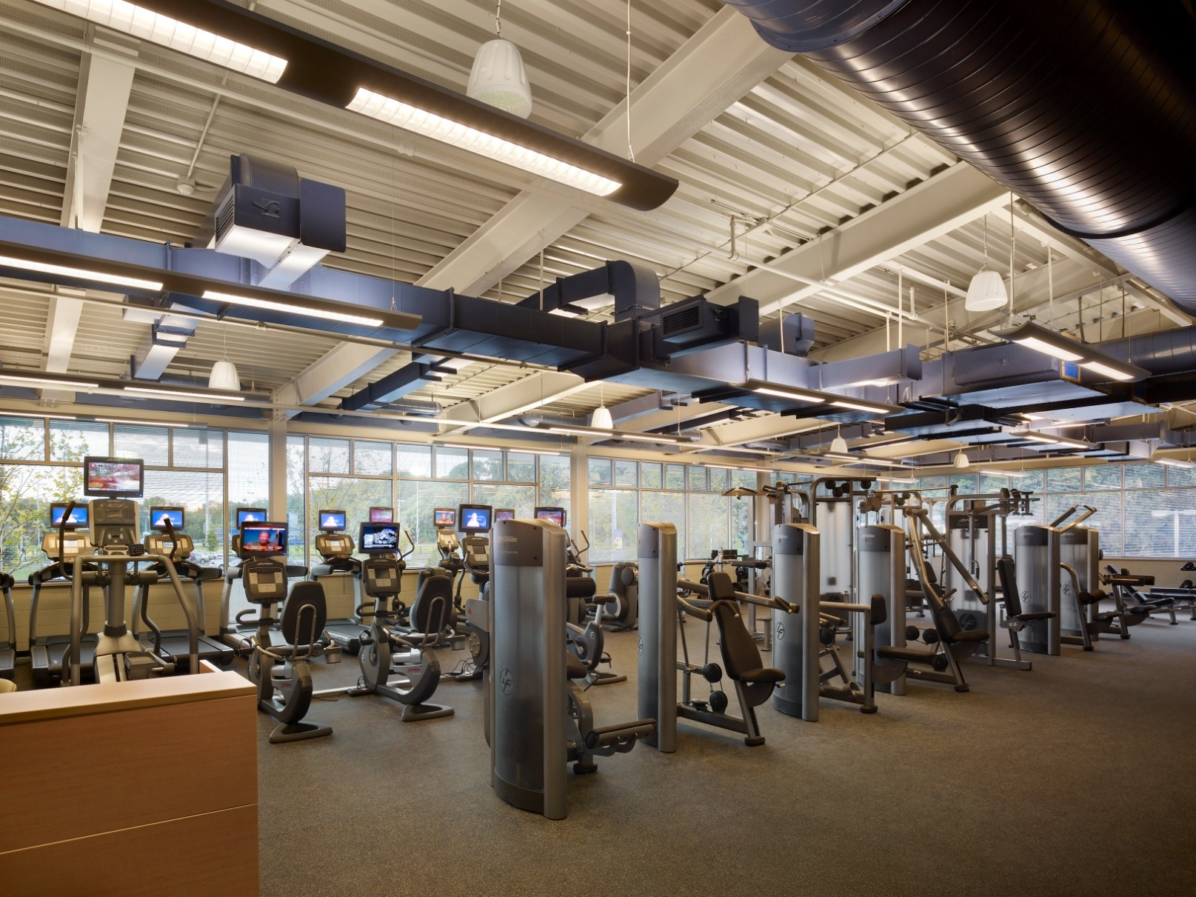
Welcoming Center
Running Track & Main Gymnasium
Fitness Center

Slide 5
6 Packaged Roof Top Units
Introduction
Building Function
Existing Mechanical System
Ground Coupled Heat Pump
Direct Expansion Cooling
Natural Gas Heating
Cost Analysis
Mezzanine Proposal
Conclusion

Slide 6
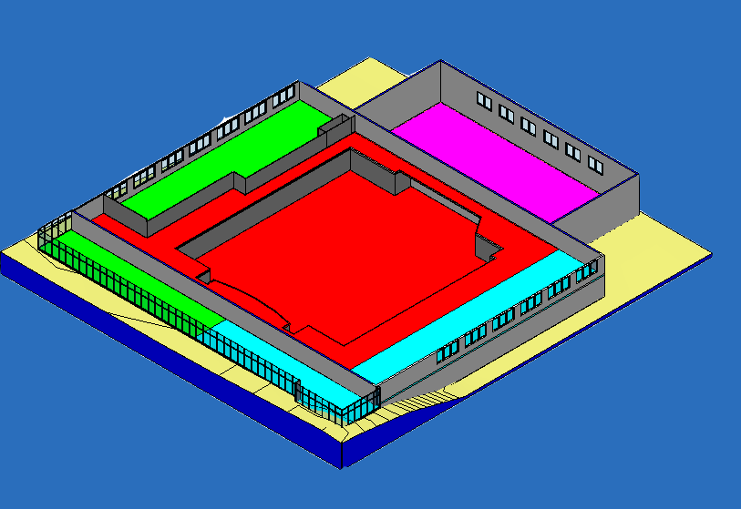
Roof Top Unit (1)
Introduction
Building Function
Existing Mechanical System
Fitness Center
Classroom
Storage
Ground Coupled Heat Pump
Cost Analysis
Mezzanine Proposal
Conclusion

Slide 7
Roof Top Unit (2)
Introduction
Building Function
Existing Mechanical System
Ground Coupled Heat Pump
Cost Analysis
Mezzanine Proposal
Conclusion
Offices
Locker Room
Maintenance

Slide 8
Roof Top Unit (3 & 4)
Introduction
Building Function
Auxiliary
Gymnasium
Existing Mechanical System
Ground Coupled Heat Pump
Cost Analysis
Mezzanine Proposal
Conclusion

Slide 9
Roof Top Unit (5 & 6)
Introduction
Building Function
Existing Mechanical System
Ground Coupled Heat Pump
Cost Analysis
Mezzanine Proposal
Conclusion
Main Gymnasium
Running Track

Slide 10
Trane Trace Energy Model
Introduction
Building Function
Existing Mechanical System
Trace Input:
Internal Loads - people, lighting
Ventilation Loads - 20% minimum
Tmy Weather Data - Philadelphia
Building Materials - walls, roof, slab
Schedule of Use - wkday, wkend, summer, winter
Ground Coupled Heat Pump
Cost Analysis
Mezzanine Proposal
Conclusion

Slide 11
Introduction
Building Function
Natural Gas Heating
Existing Mechanical System
$Eff=$ 0.85
Heating= 16 kBtu/ sf yr
Ground Coupled Heat Pump
Cost Analysis
Mezzanine Proposal
Direct Expansion Cooling
Conclusion
COP=2.8
Cooling= 22 kBtu/ sf yr
* note CBECS is Commercial Buildings Energy Consumption Survey

Slide 12
Monthly Energy Cost - Existing
Introduction
Building Function
Building Statistics
Existing Mechanical System
N. Gas =$0.05/ ccf (1000 btu/ c.f.
Consumption =$0.06 / kwh
Demand (Dmd) =$6.21 / kw
Ratchet = Dmd* 12 MONTHS
$ Heating = $13,731
$ Cooling = $82,735
$ Totals = $96,466
Ground Coupled Heat Pump
Cost Analysis
Mezzanine Proposal
Conclusion

Slide 13
Utility Rate Structure - Existing
Introduction
Building Function
Building Statistics
Existing Mechanical System
N. Gas =$0.05/ ccf (1000 btu/ c.f.
Consumption =$0.06 / kwh
Demand (Dmd) =$6.21 / kw
Ratchet = Dmd* 12 MONTHS
$ Heating = $13,731
$ Cooling = $82,735
$ Totals = $96,466
Ground Coupled Heat Pump
Cost Analysis
Mezzanine Proposal
Conclusion
Cost Breakdown of Electricity

Slide 14
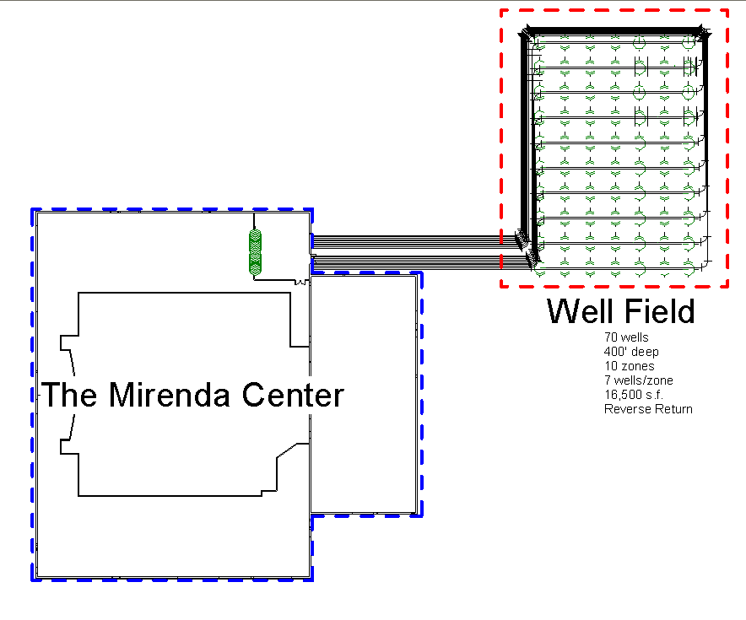
Ground Coupled Heat Pump
Introduction
Building Function
Existing Mechanical System
Ground Coupled Heat Pump
Cost Analysis
Mezzanine Proposal
Conclusion

Slide 15
Ground Coupled HP System
Introduction
Building Function
Existing Mechanical System
Rule of Thumb
Ground Coupled Heat Pump
Well Sizing = 150 ft/ ton
Cooling = 460 tons
Heating = 1291 Mbh
Depth of Well = 400 ft
Wells Cooling = 172 wells
Cost Analysis
Mezzanine Proposal
Conclusion

Slide 16
Ground Coupled HP System
Introduction
Building Function
Existing Mechanical System
ASHRAE Calculation
Well Size = 171 ft/ton
Cooling = 460 tons
Heating = 1291 Mbh
Depth of Well = 400 ft
Wells Cooling = 199 wells
Wells Heating = 42 wells
Ground Coupled Heat Pump
Cost Analysis
Mezzanine Proposal
Conclusion

Slide 17
Total Energy Comparison
Introduction
Building Function
Existing Mechanical System
Heat Pump Calculation
COP = 4.5
Heating = 4 kBtu/ sf yr
Cooling = 14 kBtu/ sf yr
20-40 ft ceiling height
Ground Coupled Heat Pump
Cost Analysis
Mezzanine Proposal
Conclusion

Slide 18
Ground Coupled HP System
Introduction
Building Function
Existing Mechanical System
Building Statistics
$ Heating = $4,274
$ Cooling = $51,026
$ Total = $55,298
Savings = $41,168
Conventional DX Gas = $1.33/s.f.
GCHP = $0.76/s.f.
Ground Coupled Heat Pump
Cost Analysis
Mezzanine Proposal
Conclusion

Slide 19
Cost Analysis
Introduction
Building Function
Existing Mechanical System
Cost of (6) RTU | $476,269
Unit Well Cost (Grout + Pipe + Drilling ) | $8,104 | $1,612,767
Distribution Piping Zone (2) Pipes per Zone | $1,990 | $33,007
Pumps + Elbows + Tees + Valves per zone | $650 | $10,779
Number of Wells | 199
Number of Zones | 12
Total Cost |  | $2,132,822
Cost of GCHP Wells |  | $1,656,553
Payback the Cost of Wells |  | 40
Ground Coupled Heat Pump
Cost Analysis
Mezzanine Proposal
Conclusion

Slide 20
Cost Analysis
Introduction
Building Function
Existing Mechanical System
Cost of (6) RTU | $476,269
Unit Well Cost (Grout + Pipe + Drilling ) | $8,104 | $1,612,767
Distribution Piping Zone (2) Pipes per Zone | $1,990 | $33,007
Pumps + Elbows + Tees + Valves per zone | $650 | $10,779
Number of Wells | 199
Number of Zones | 12
Total Cost |  | $2,132,822
Cost of GCHP Wells |  | $1,656,553
Payback the Cost of Wells |  | 40
Ground Coupled Heat Pump
Cost Analysis
Mezzanine Proposal
Conclusion

Slide 21
Hybrid GCHP with Cooling Tower

Slide 22
Hybrid GCHP with Cooling Tower
Introduction
Building Function
Existing Mechanical System
Ground Coupled Heat Pump
Cost Analysis
Mezzanine Proposal
Conclusion

Slide 23
Hybrid GCHP with Cooling Tower
Introduction
Building Function
Cost of (6) RTU | $476,269
Well Cost (Grout + Pipe + Drilling ) | $8,104 | $567,305
Distribution Piping Zone (2) Pipes per Zone | $1,990 | $13,933
Pumps + Elbows + Tees + Valves per zone | $650 | $4,550
Cooling Tower |  | $50,000
Number of Wells | 70
Number of Zones | 10
Total Cost |  | $1,112,057
Cost of GCHP Wells |  | $635,788
Payback |  | 18
Existing Mechanical System
ASHRAE Calculation
Well Size = 171 ft/ton
Cooling = 200 tons
Heating = 1291 Mbh
Depth of Well = 400 ft
Wells Cooling = 70 wells
Wells Heating = 42 wells
Footprint = 27,976 ft²
Pattern = 20 by 20 Grid
Ground Coupled Heat Pump
Cost Analysis
Mezzanine Proposal
Conclusion

Slide 24
Cost Analysis
Introduction
Building Function
Energy Statistics
Ex. Heating = 16 kBtu/ sf year
Ex. Cooling = 22 kBtu/ sf year
Ex. Total = 38 kBtu/ sf year
GCHP Heating = 4 kBtu/ sf year
GCHP Cooling = 14 kBtu/ sf year
GCHP Total = 18 kBtu/ sf year
Savings =20 kBtu/ sf year
Existing Mechanical System
Ground Coupled Heat Pump
Cost Analysis
Mezzanine Proposal
Conclusion

Slide 25
Mezzanine Proposal
Introduction
Building Function
Structural & Lighting Breadth
Existing Mechanical System
Load & Resistance Factor Design – Conditions
Dead Load= | 40 | psf
Self-Weight= | 45 | psf
Live Load= | 80 | psf
Total Factored Load= | 1.2*(Dead)+1.6*(Live)
Mezzanine Width= | 12 | ft
Mezzanine Length= | 70 | ft
Total Thickness= | 5.5 | inches
Number of Bays= | 8
Total Unfactored Load (no concrete self-weight)= | 120 | psf
Total Unfactored Load (with concrete self-weight)= | 165 | psf
Total Factored Load= | 230 | psf
Ground Coupled Heat Pump
Cost Analysis
Mezzanine Proposal
Conclusion

Slide 26
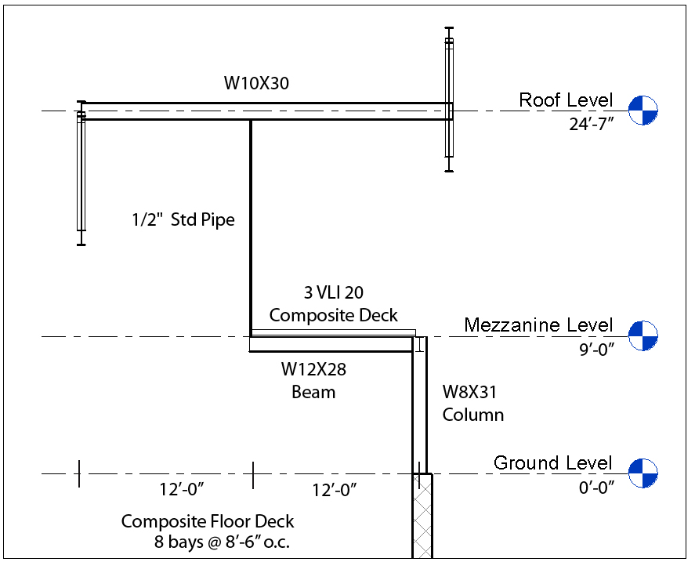
Mezzanine Proposal
Introduction
Building Function
Structural Breadth
Existing Mechanical System
Load & Resistance Factor Design – Conditions
Dead Load= | 40 | psf
Self-Weight= | 45 | psf
Live Load= | 80 | psf
Total Factored Load= | 1.2*(Dead)+1.6*(Live)
Mezzanine Width= | 12 | ft
Mezzanine Length= | 70 | ft
Total Thickness= | 5.5 | inches
Number of Bays= | 8
Total Unfactored Load (no concrete self-weight)= | 120 | psf
Total Unfactored Load (with concrete self-weight)= | 165 | psf
Total Factored Load= | 230 | psf
Ground Coupled Heat Pump
Cost Analysis
Mezzanine Proposal
Conclusion

Slide 27
Overview & Recommendation
Cost of (6) RTU | $476,269
Well Cost (Grout + Pipe + Drilling ) | $8,104 | $567,305
Distribution Piping Zone (2) Pipes per Zone | $1,990 | $13,933
Pumps + Elbows + Tees + Valves per zone | $650 | $4,550
Cooling Tower |  | $50,000
Number of Wells | 70
Number of Zones | 10
Total Cost |  | $1,112,057
Cost of GCHP Wells |  | $635,788
Payback |  | 18
Energy Statistics
Ex. Heating = 16 kBtu/ sf year
Ex. Cooling = 22 kBtu/ sf year
Ex. Total = 38 kBtu/ sf year
GCHP Heating = 4 kBtu/ sf year
GCHP Cooling = 14 kBtu/ sf year
GCHP Total = 18 kBtu/ sf year
Savings = 20 kBtu/ sf year
$ Savings = $35,321
Conventional DX Gas = $1.33/s.f.
GCHP = $0.84/s.f.

Slide 28
The Mirenda Center for Sport Spirituality and Character Development
Thank you…
Zachary Heilman
Mechanical Option | 2011
Dr. Jim Freihaut | Dustin Eplee

